Slide 1
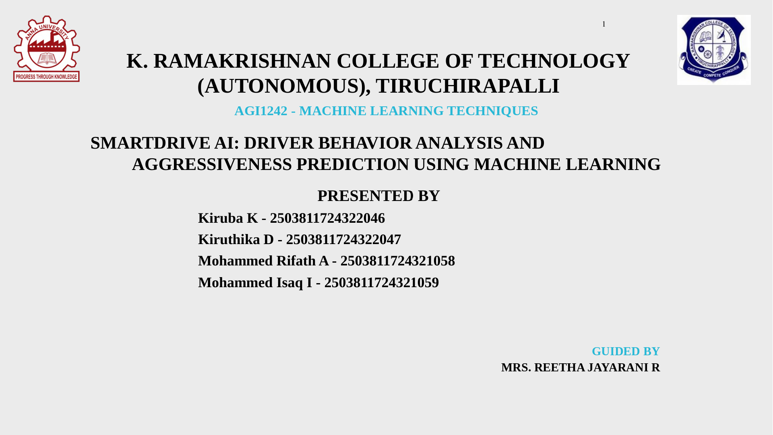

Slide 2
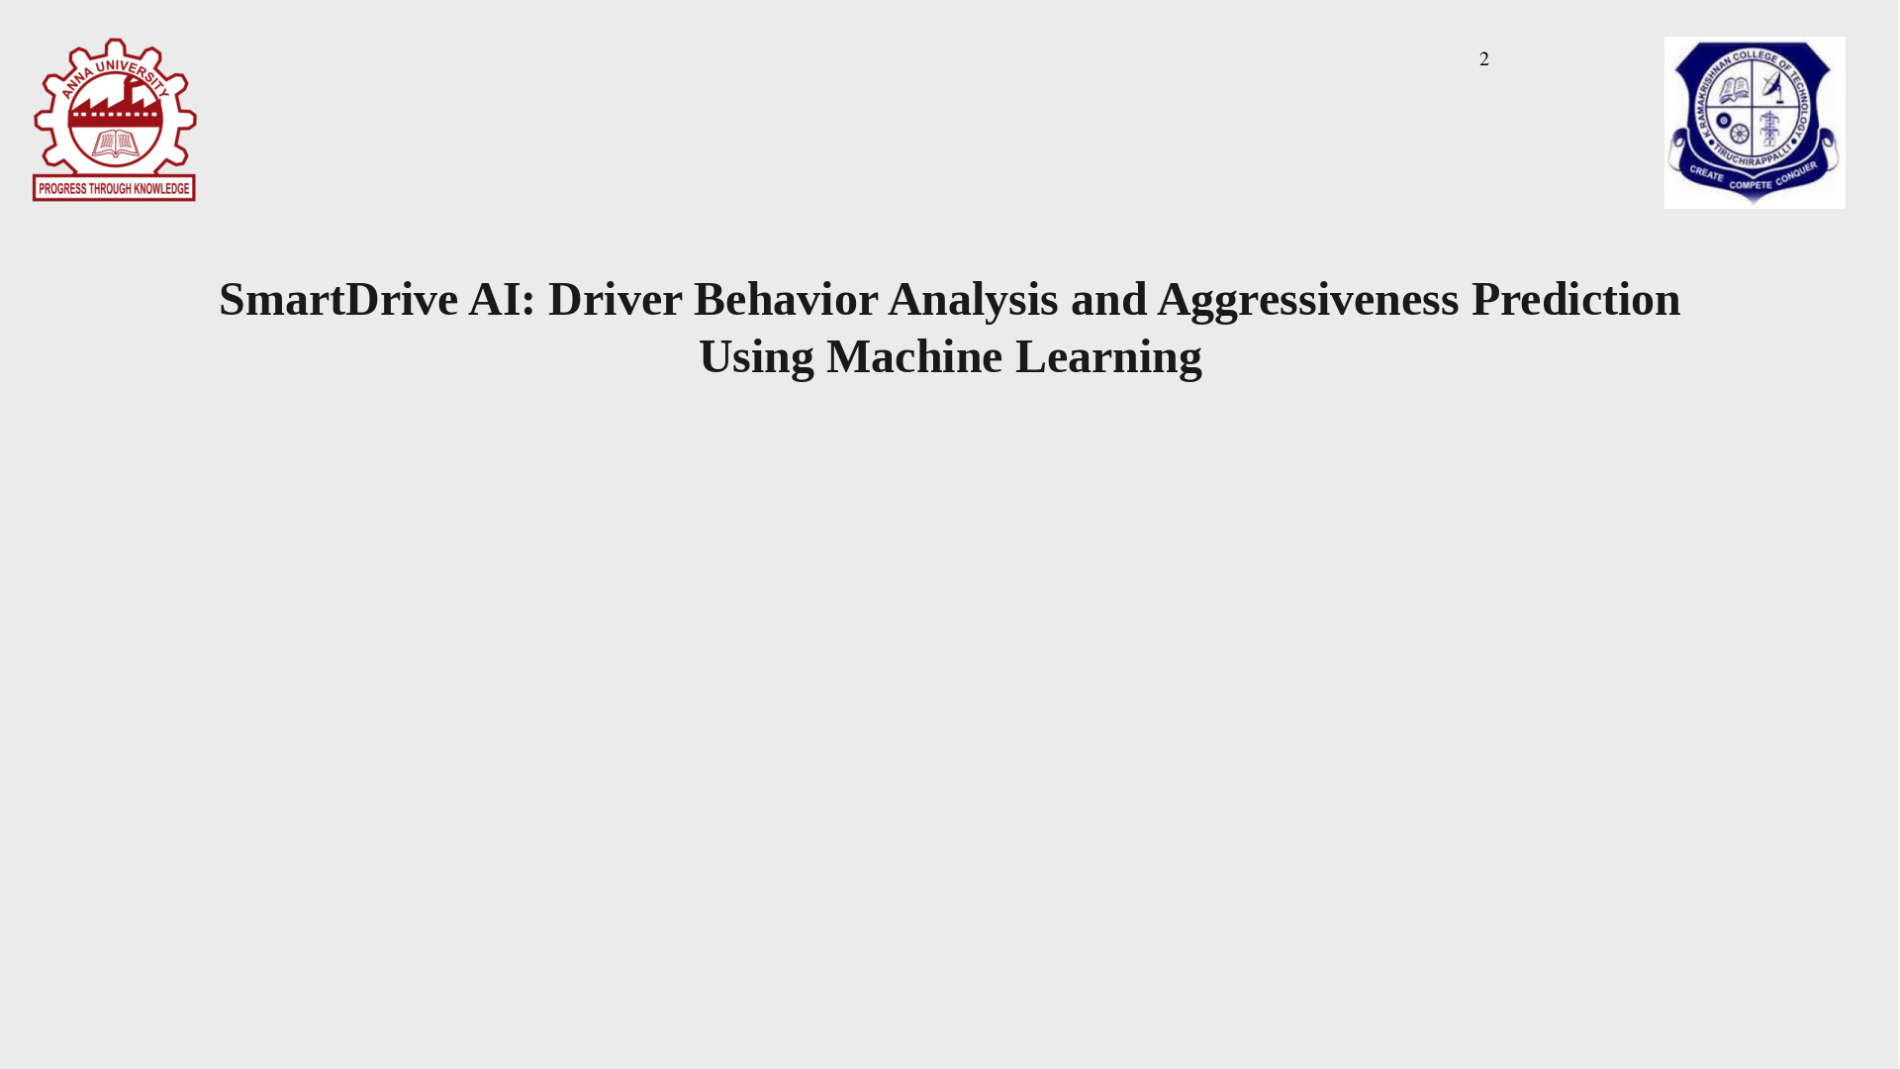

Slide 3
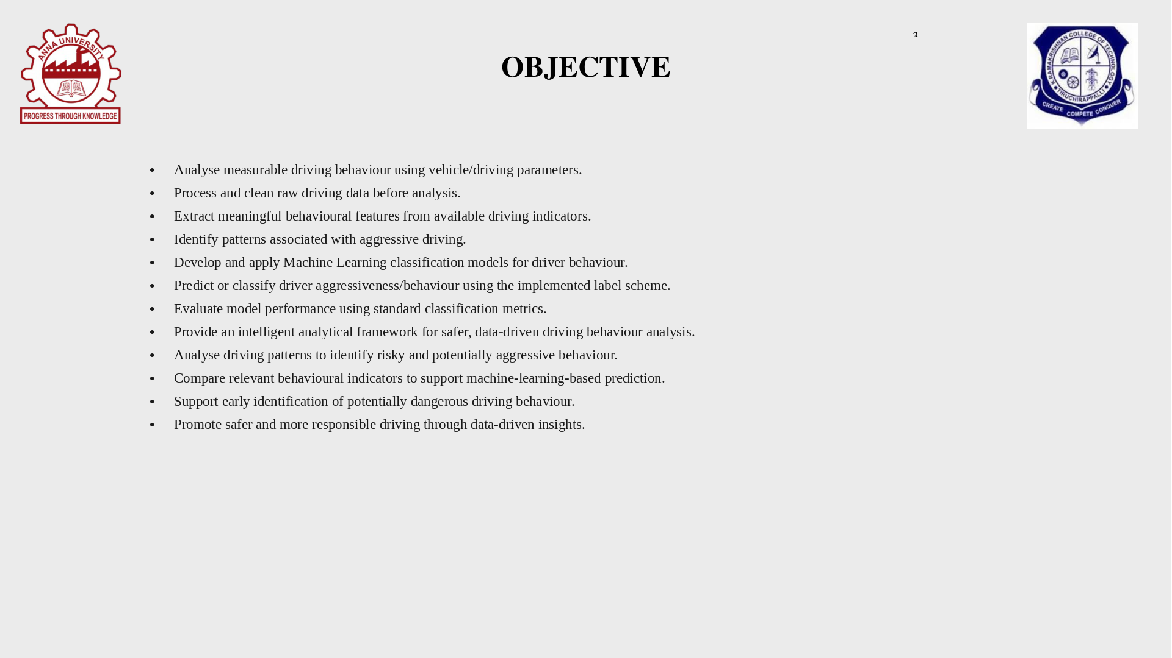

Slide 4
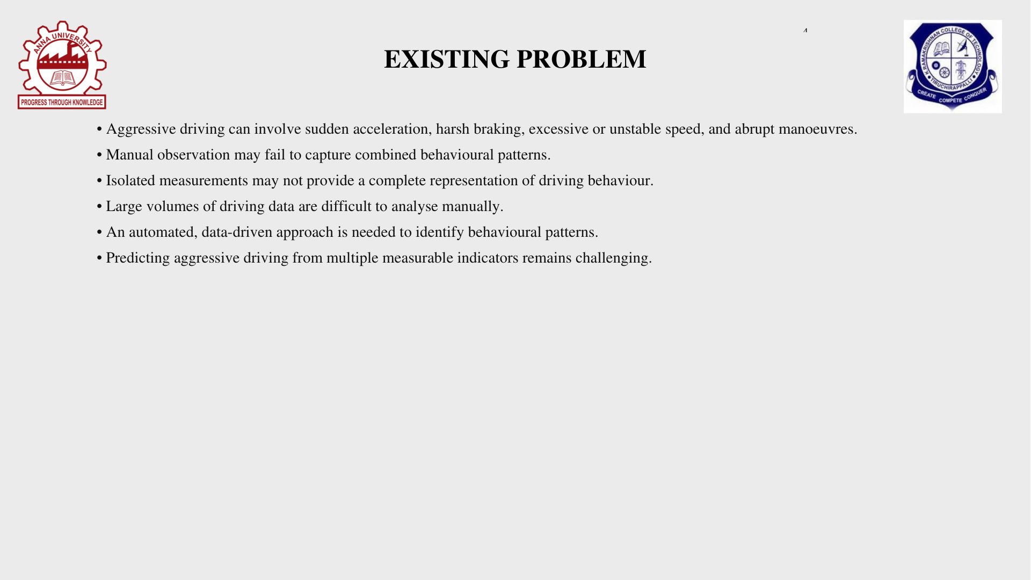

Slide 5
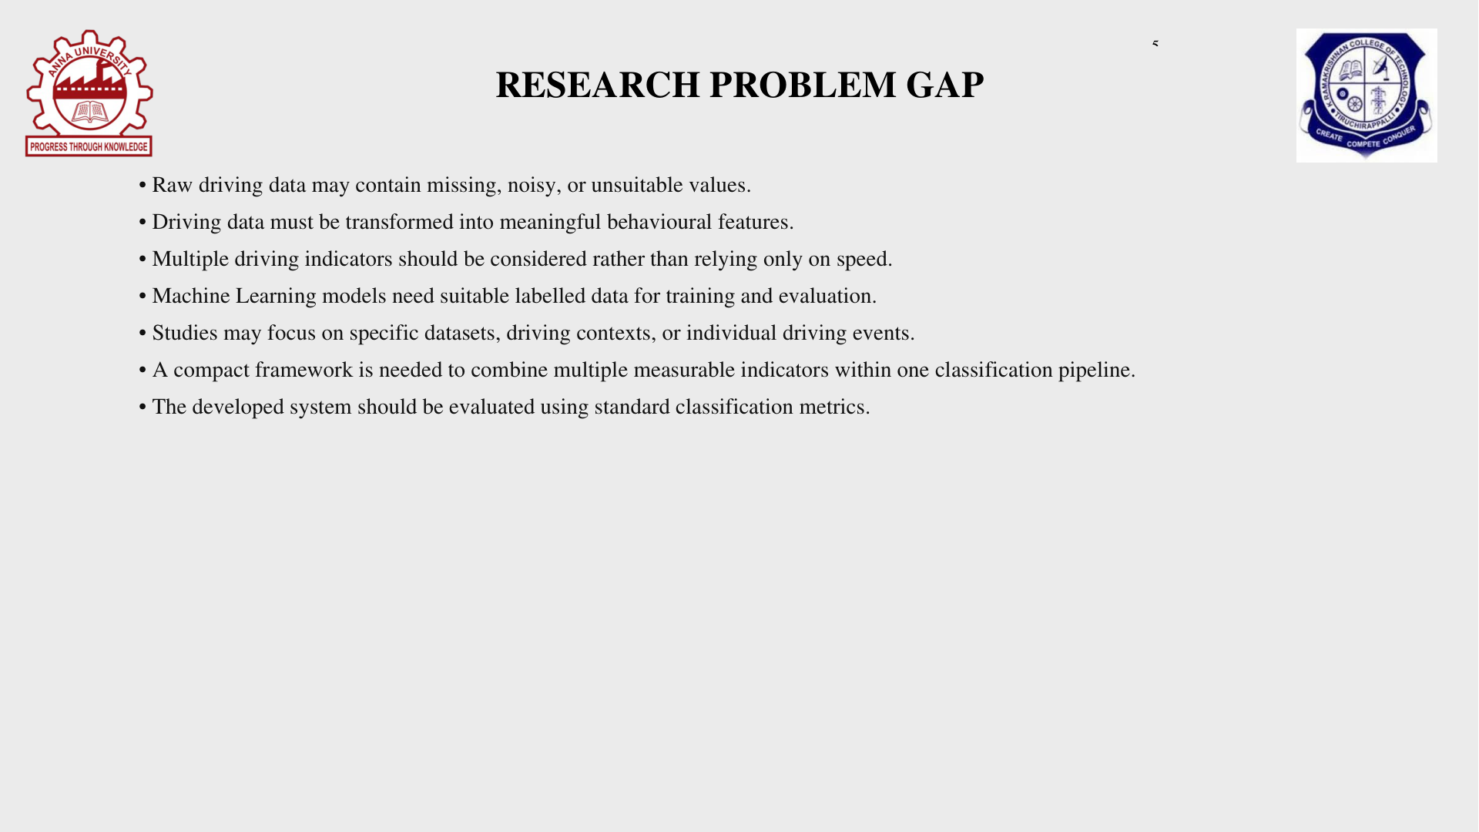

Slide 6
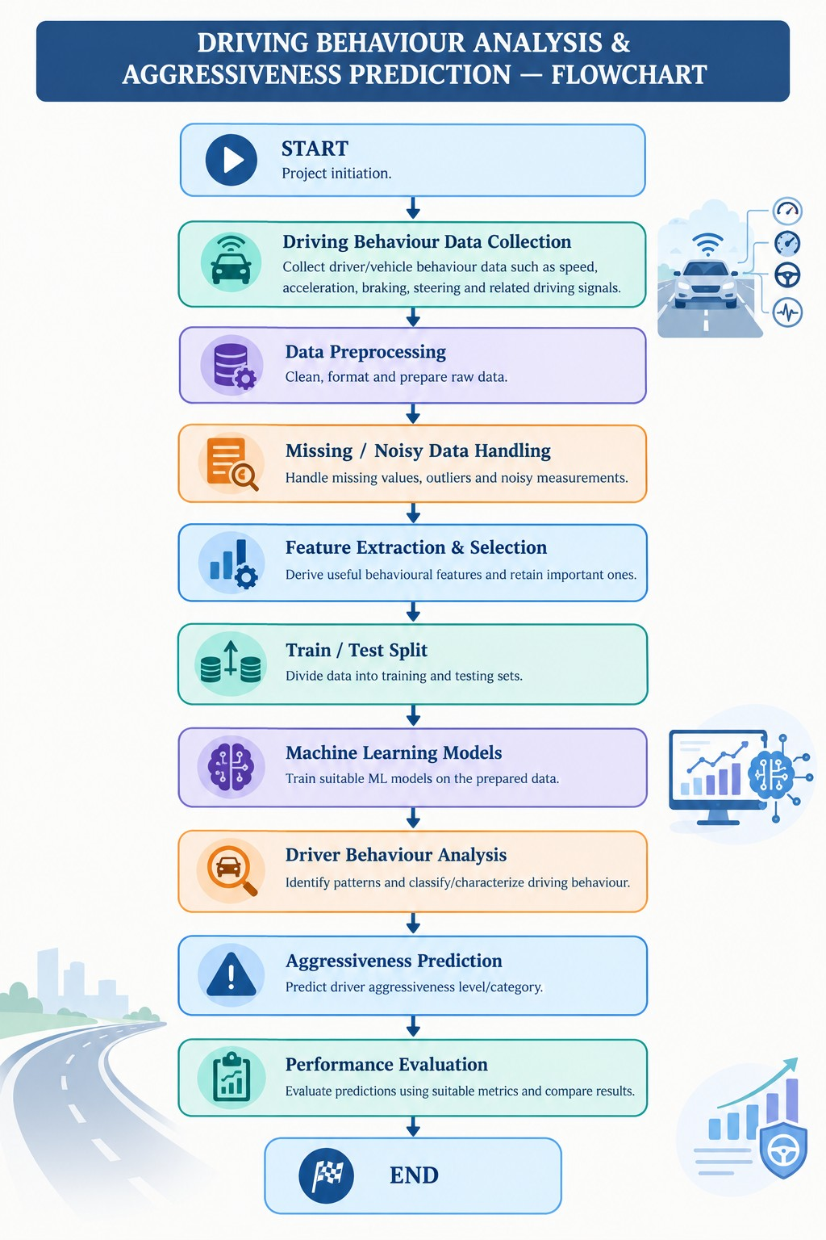



Slide 7
LITERATURE SURVEY
A comprehensive review on data-driven driver behaviour scoring in vehicles
Shirole, Shahade & Deshmukh (2025)
VIEW RESEARCH PAPER
https://doi.org/10.1007/s44163-025-00244-6

Slide 8
LITERATURE SURVEY
Driving style classification and recognition methods for connected vehicle control in intelligent transportation systems: A review
Mei et al. (2025)
VIEW RESEARCH PAPER
https://doi.org/10.1016/j.isatra.2025.01.033

Slide 9
LITERATURE SURVEY
Driving Style Recognition for Intelligent Vehicle Control and Advanced Driver Assistance: A Survey
Martinez et al. (2018)
VIEW RESEARCH PAPER
https://doi.org/10.1109/TITS.2017.2706978

Slide 10
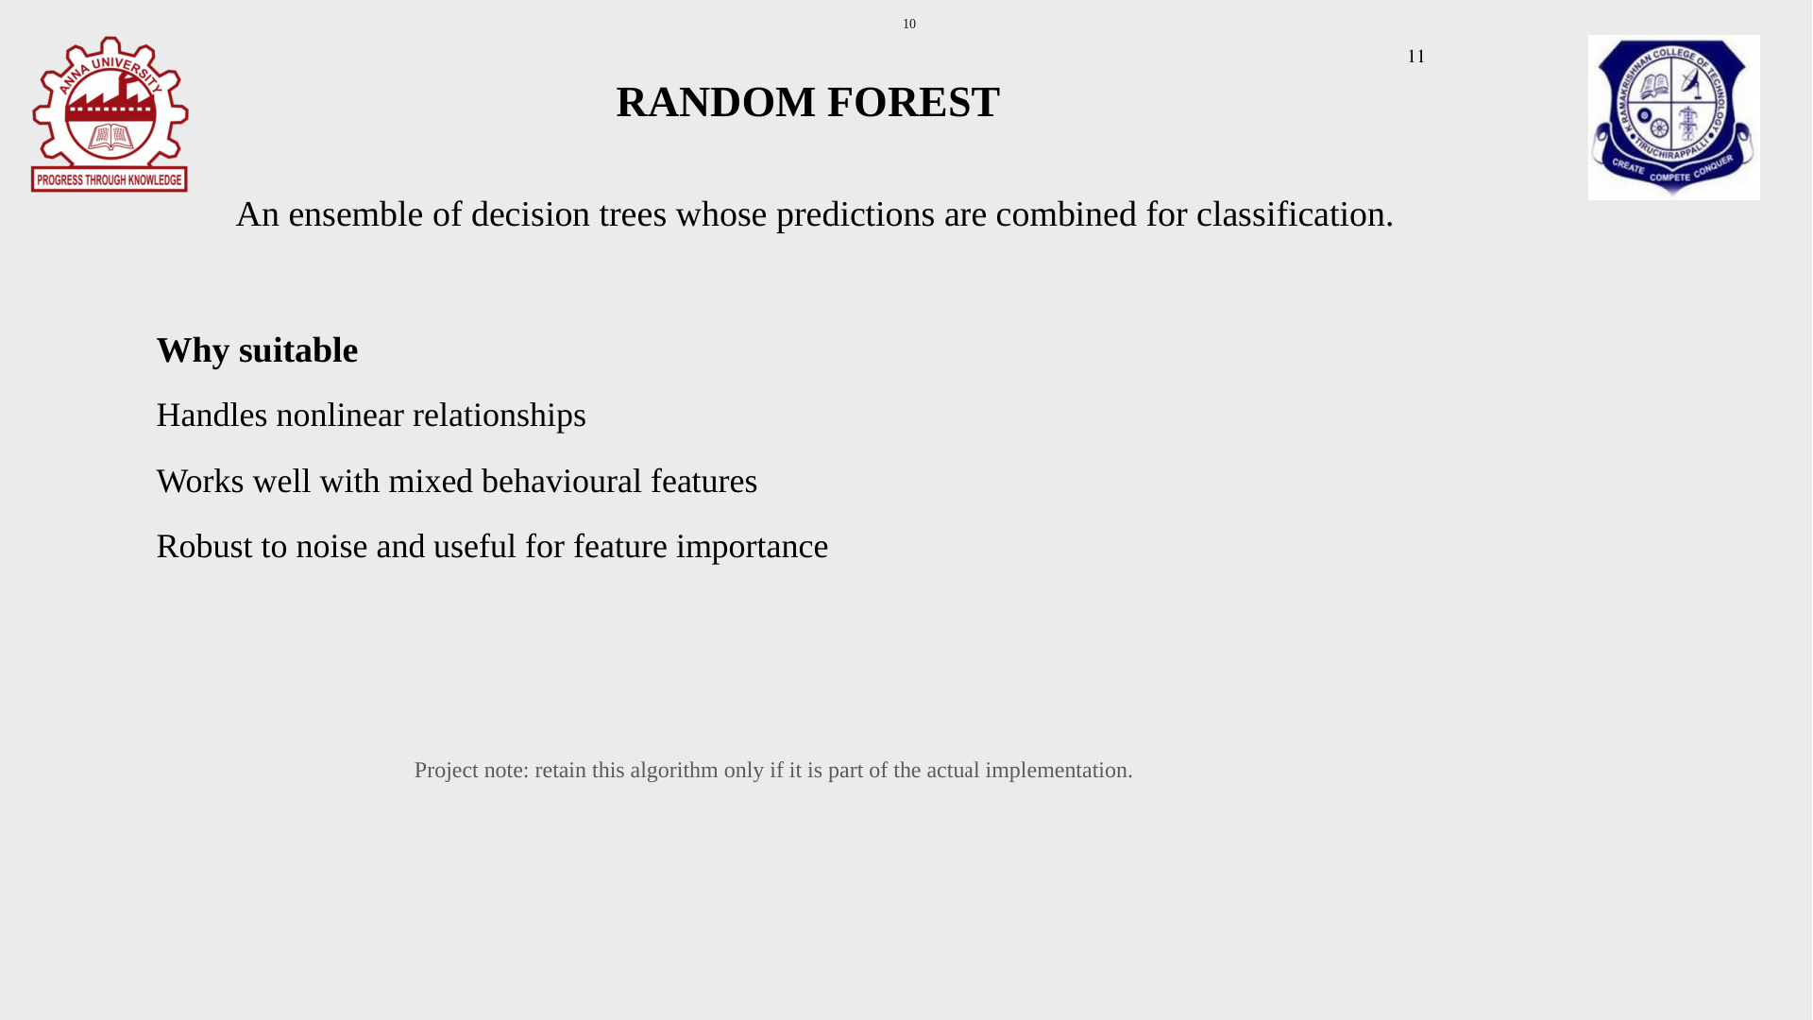

Slide 11
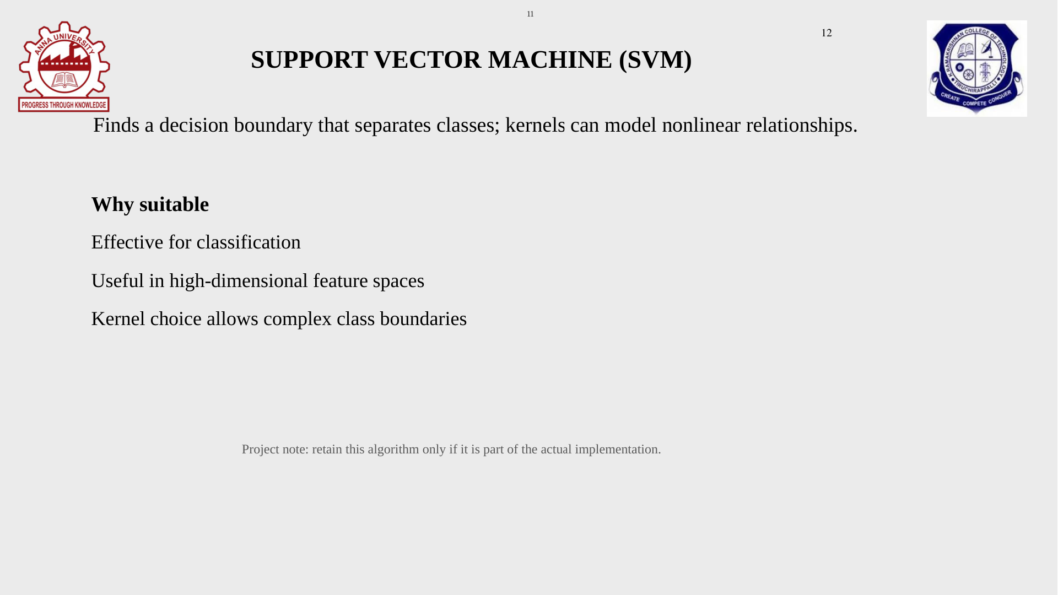

Slide 12
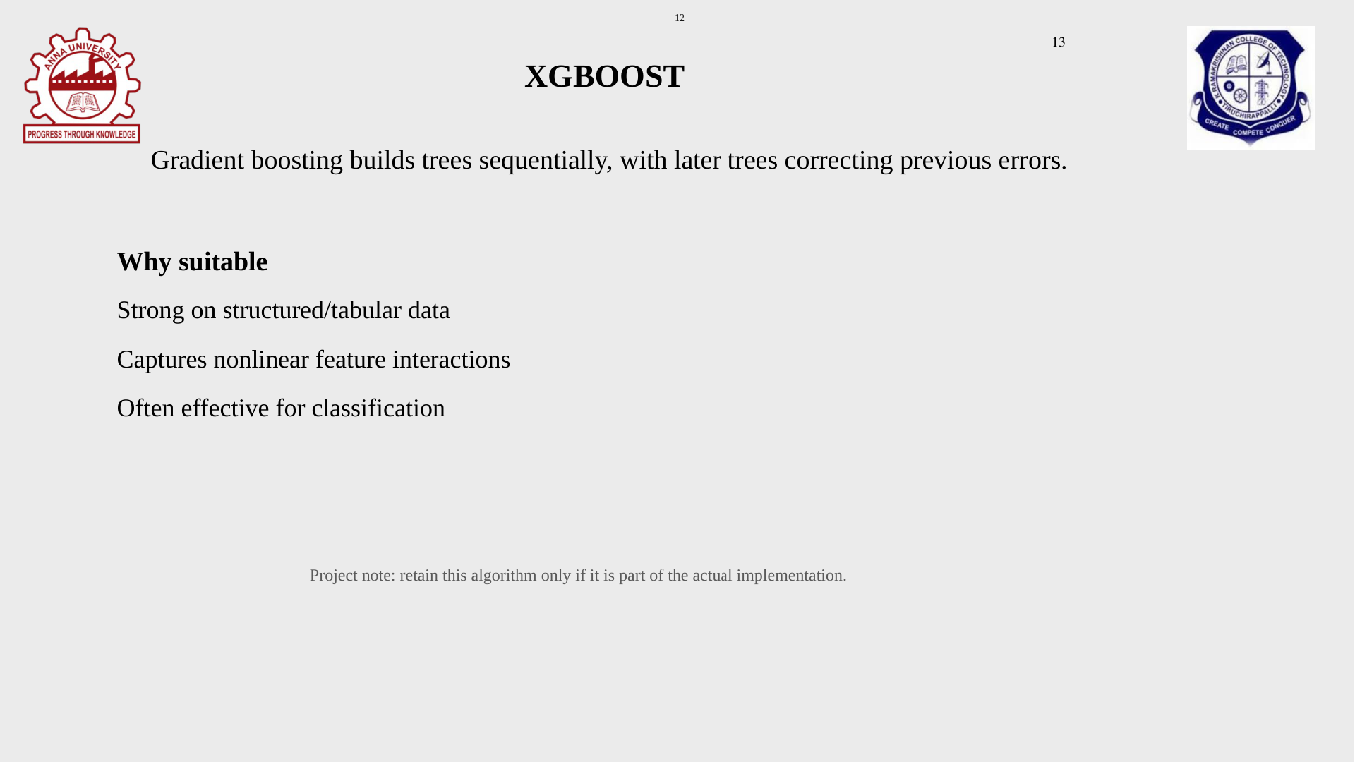

Slide 13
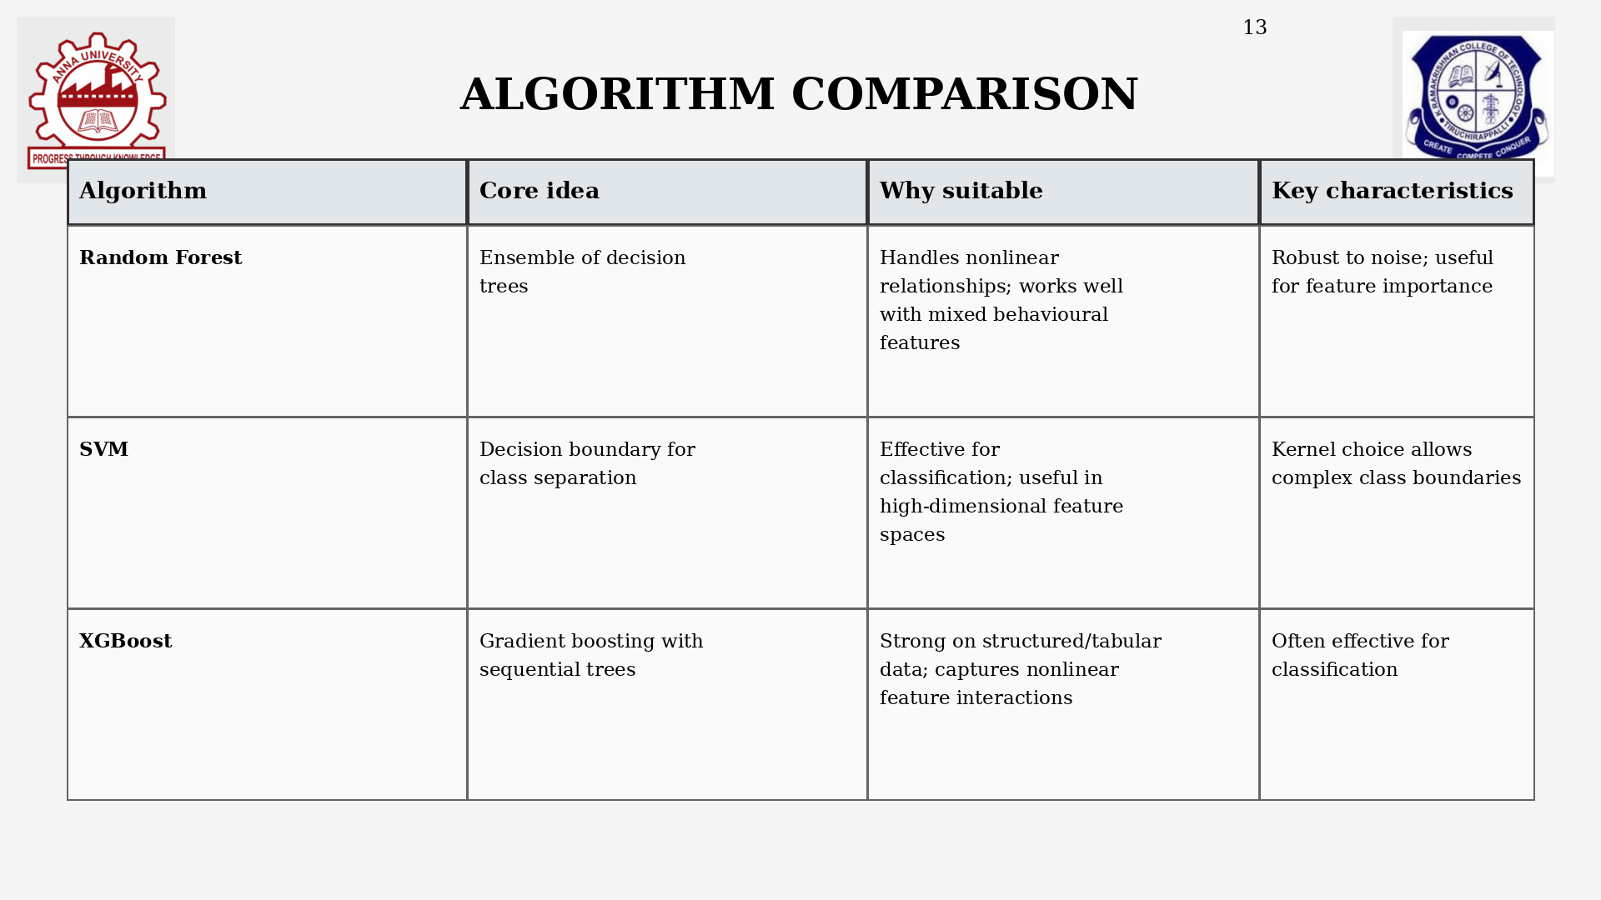

Slide 14
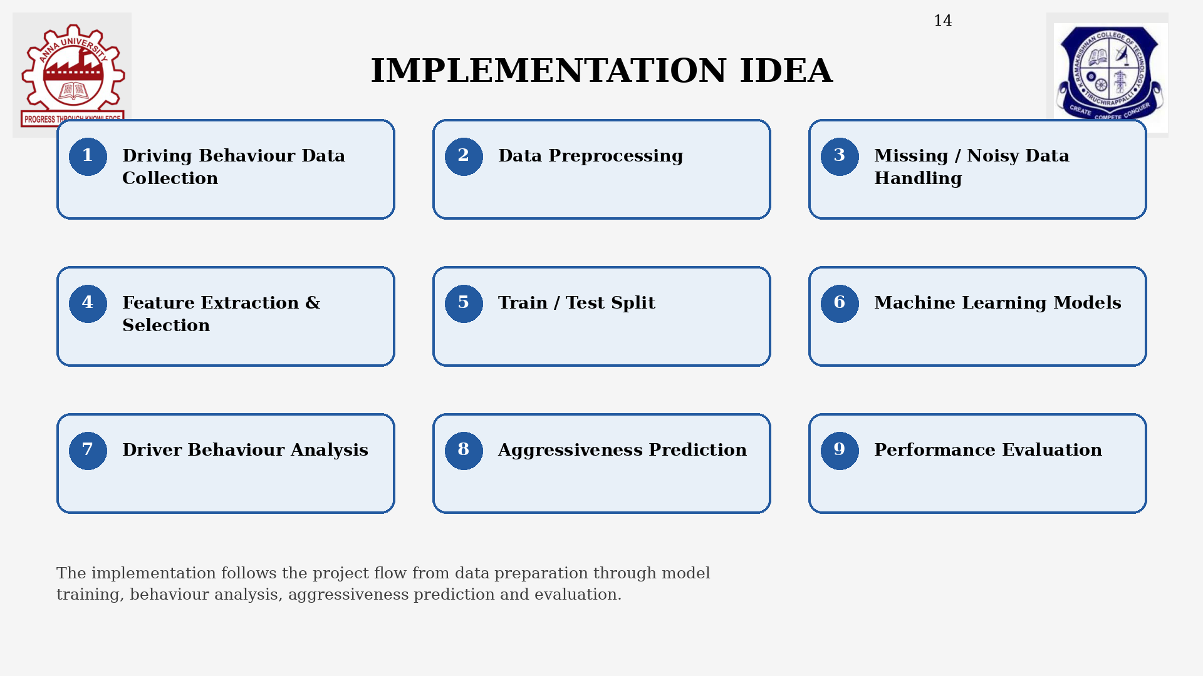

Slide 15
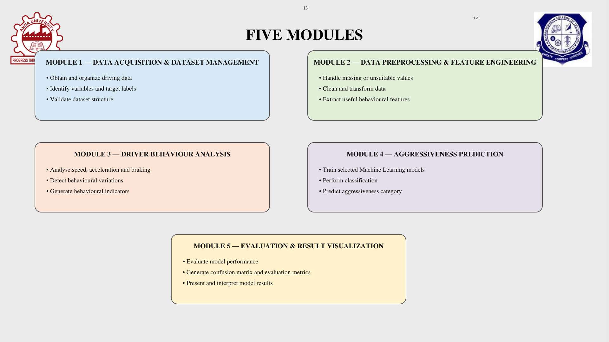

Slide 16
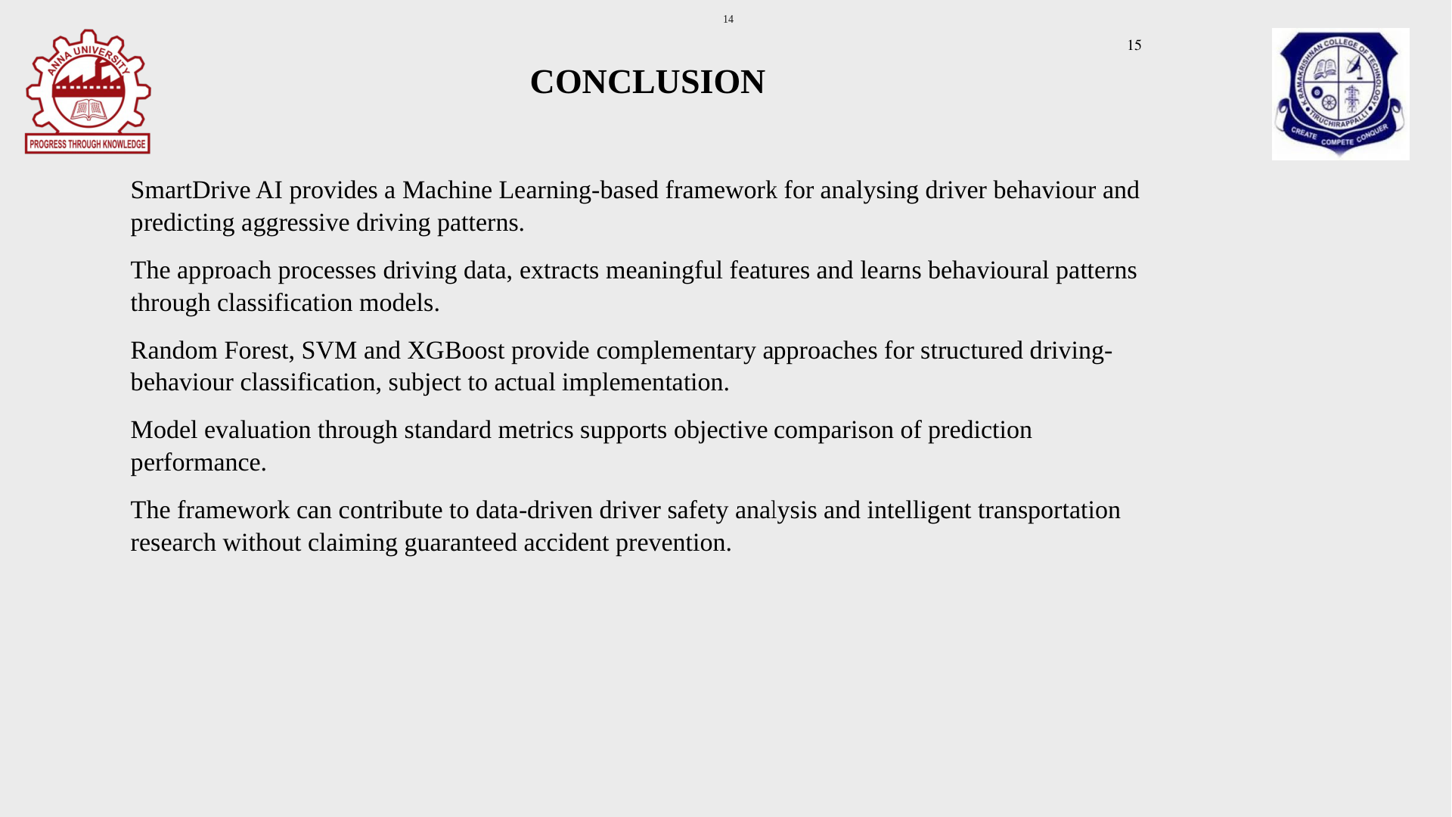

Slide 17
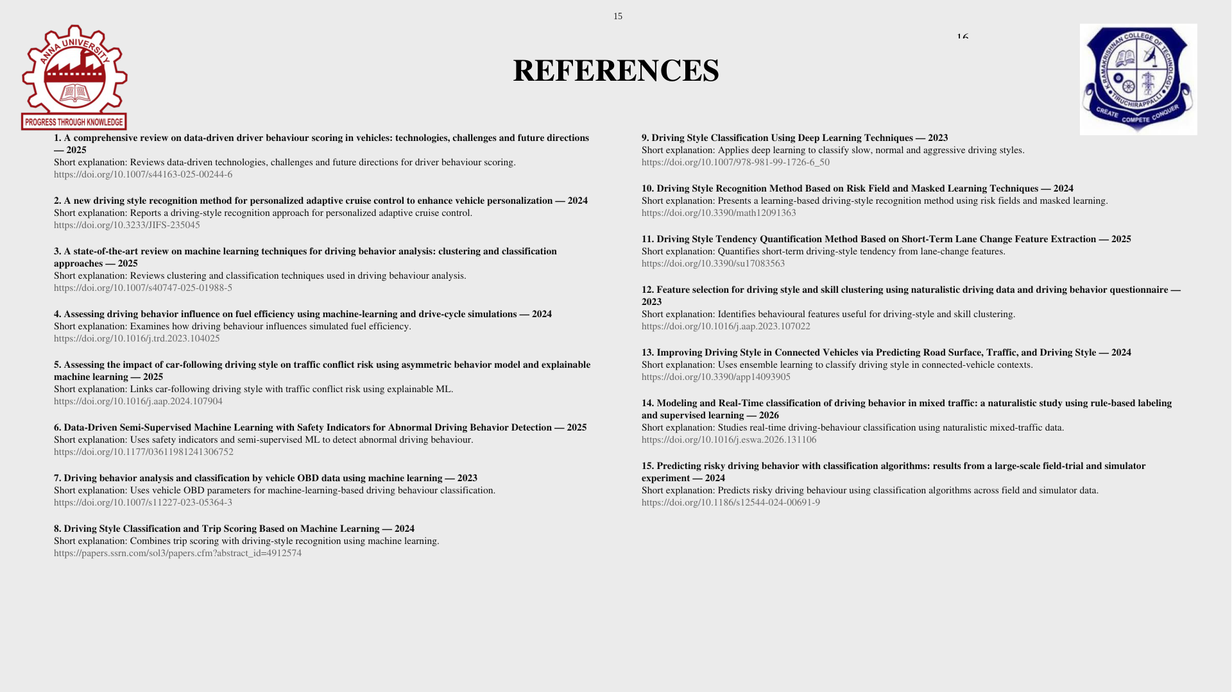

Slide 18


  THANK YOU

